Slide 1
Literature Survey on Temporal Graph Stores and Processing Presentation - 1
Shriram R
07-Jun-19

Slide 2
BadWolf [1]
Triplestore (<subject> <predicate> <object>) with temporality
Immutable – Nodes, Literals and Predicates
Time anchors (range of validity) for each triple
Storage Abstraction Layer
Does not provide storage (But a naïve implementation is available)
Provides only low level API for persistence
Need to write driver for different storage backends
No indexing mechanism
Can be implemented using the storage driver

Slide 3
BadWolf [1]
BadWolf Query Language (BQL)
Syntax similar to SQL
Provides support for Create, Drop, Select, Insert, Delete in general
Mainly supports traversal and pattern matching queries
Query Planning
Naïve Specificity based optimization
E.g. /user<Joe> "parent-of"@[] ?child . ?child "parent-of"@[] ?grand_child
Creates a graph based on where clause
Edge between two clauses if they share a binding
Starts with higher specificity nodes and proceeds towards lower specificity

Slide 4
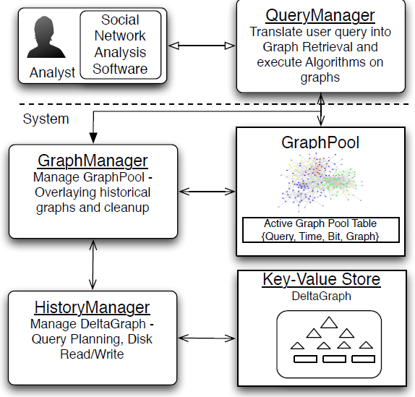
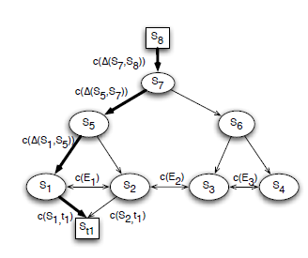
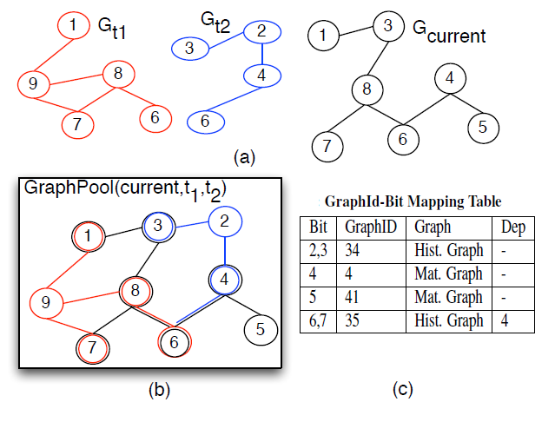
Efficient Snapshot Retrieval over Historical Graph Data [2]
DeltaGraph – Distributed hierarchical index structure
GraphPool – in-memory historical graph data structure

Slide 5
Efficient Snapshot Retrieval over Historical Graph Data [2]
Optimizations
Maintain statistics of deltas and eventlist in memory
Materialize certain nodes in memory
Parameter Tuning – Choosing differential function and arity
Efficient usage of bitmaps for in-memory store
Gaps
Effect of partitioning and need of repartitioning
Behaviour on graphs with different topologies and more real-world graphs
Structural and Property changes are treated alike
Support for queries that retrieve snapshots satisfying a given predicate

Slide 6
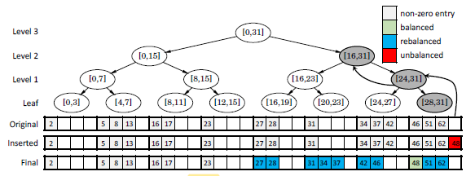
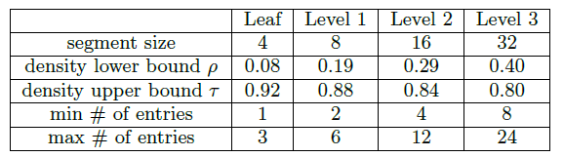
Accelerating Dynamic Graph Analytics on GPUs [3]
GPU based dynamic graph storage scheme
Parallel update algorithms supporting stream updates
Uses Packed Memory Array (PMA) for storage

Slide 7
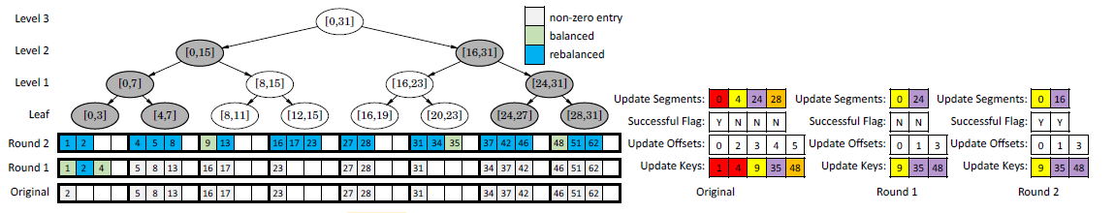
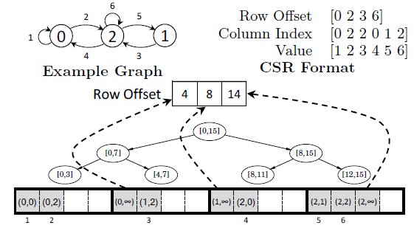
Accelerating Dynamic Graph Analytics on GPUs [3]
Updates are sorted by keys and dispatched according to the sorted order
Updates for same leaf segments are grouped for processing
Uses Run length encoding and exclusive scan GPU primitives

Slide 8
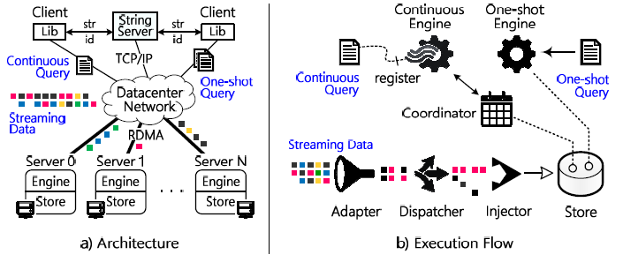
Sub-millisecond Stateful Stream Querying over Fast-evolving Linked Data [4]
Wukong+S – Stream processor and persistent storage & state sharing
Hybrid store with efficient stream index and locality aware partitioning
Fault tolerance using checkpointing
At least once semantics
Bounded snapshot scalarization
Implemented on RDMA based nodes

Slide 9
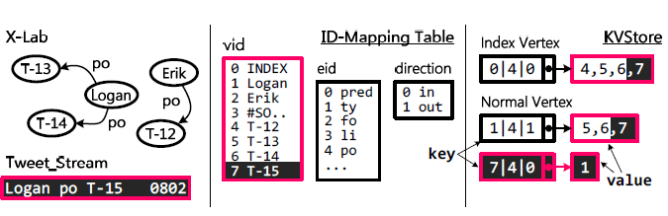
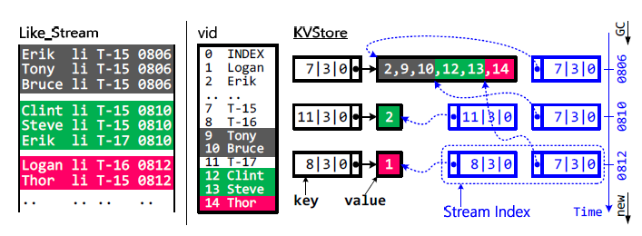
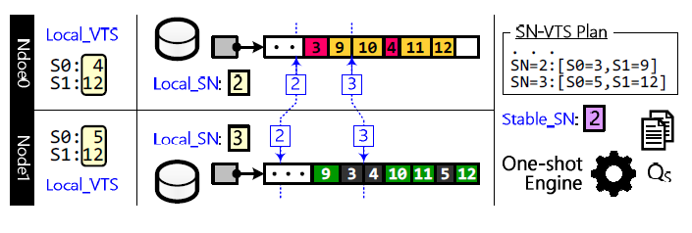
Sub-millisecond Stateful Stream Querying over Fast-evolving Linked Data [4]

Slide 10
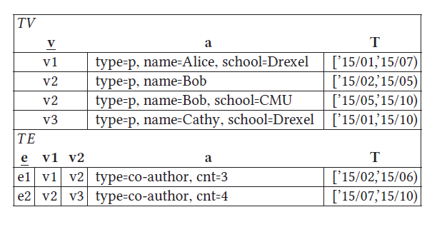
Temporal Graph Algebra [5]
TGraph – Temporal graph representation (relational model)
TGA – Temporal graph algebra
Point based semantics
Discretized time domain
Two tables: TV and TE
Point based semantics
Provides different constraints on relations

Slide 11
Temporal Graph Algebra [5]
Temporal Graph Algebra Operators
Trim (Filter nodes and edges)
Map (transform vertex/edges with properties using a given function)
Subgraph (pattern matching)
Aggregation (group by)
Set based (Union and Intersection)
Node and edge creation
Formal Temporal Properties
Temporal groupedness
Temporal completeness

Slide 12
The Gremlin Graph Traversal Machine and Language [2]
Supports Graph traversal and pattern matching queries.
Composed of a Graph, a traversal and set of traversers.
Traversal language consists of map, flatMap, filter, sideEffect & branch
Traversers are isolated entities with their own state.
Traverser set can grow and shrink. If multiple options are met, then all options are taken.
Bulking collapses a traverser set constrained to an upper limit.
Can be run on top of any OLTP/OLAP graph processor.

Slide 13
The Gremlin Graph Traversal Machine and Language [3]
Traversal Strategies
Decoration (E.g. ConjunctionStrategy)
Optimization (E.g. IncidentToAdjacentStrategy)
Vendor Optimization (E.g. XGraphStepStrategy)
Finalization (E.g. ProfileStrategy)
Verification (E.g. ComputerVerificationStrategy)
Vertex Centric BSP model for computation
Vertices receive traversers and execute traversal step on each traverser
Vertices save the state of halted traversers
Sends message to respective next vertices of traversers

Slide 14
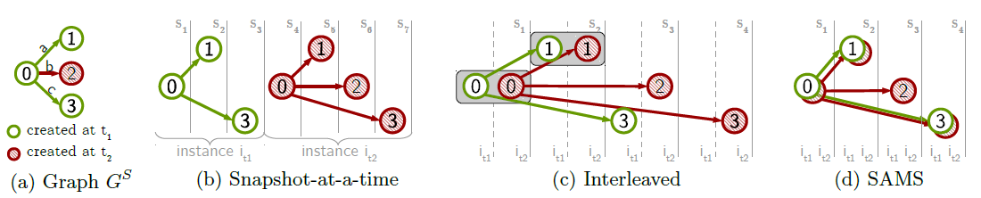
Automatic Algorithm Transformation for Efficient Multi-Snapshot Analytics on Temporal Graphs [2]
Rule-based transformation of algorithms to multi-snapshot version
Amortizes data access cost & improves memory utilization

Slide 15
Automatic Algorithm Transformation for Efficient Multi-Snapshot Analytics on Temporal Graphs [3]
Optimizations
Transformation rules can cover all MS algorithms
Cache friendly implementation using synchronous data access
Leverages SIMD instructions using spatially local data layout
Global aggregated statistics
Gaps
Does not support time dependent (TD) algorithms
Single machine version. Not applicable for distributed processing
Evaluation considers only small graphs ( < 100 million edges)

Slide 16
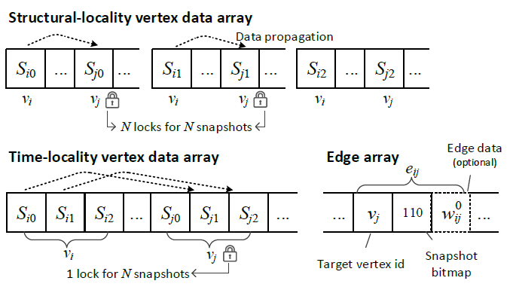
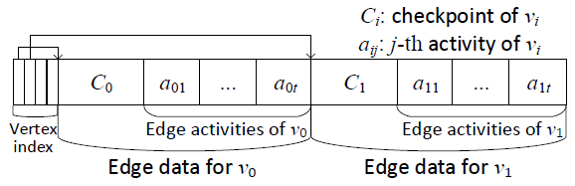
Chronos: A Graph Engine for Temporal Graph Analysis [4]
Uses time locality for graph layout in memory.
Batches operations for each vertex across snapshots.
Locality-Aware Batch Scheduling (LABS)
Scatter-Gather Execution model
Works with Push, Pull & Stream modes.

Slide 17
Chronos: A Graph Engine for Temporal Graph Analysis [4]
Optimizations
Assigns different partitions instead of snapshots to different cores
Incremental computation from previous snapshot
Edge array sorted by source vertices and bitmap for snapshot containment
Gaps
Support for TD algorithms
Comparatively less speedup (3x) in distributed setting
Need evaluation for Graph mining (Pattern matching) problem

Slide 18
References
https://github.com/google/badwolf
Khurana, Udayan, and Amol Deshpande. "Efficient snapshot retrieval over historical graph data." 2013 IEEE 29th International Conference on Data Engineering (ICDE). IEEE, 2013.
Sha, Mo, et al. "Accelerating dynamic graph analytics on gpus." Proceedings of the VLDB Endowment 11.1 (2017): 107-120.
Zhang, Yunhao, Rong Chen, and Haibo Chen. "Sub-millisecond stateful stream querying over fast-evolving linked data." Proceedings of the 26th Symposium on Operating Systems Principles. ACM, 2017.
Moffitt, Vera Zaychik, and Julia Stoyanovich. "Temporal graph algebra." Proceedings of The 16th International Symposium on Database Programming Languages. ACM, 2017.

